Slide 1

Digital Design and Verification Training
System Verilog

Slide 2
Agenda

Slide 3
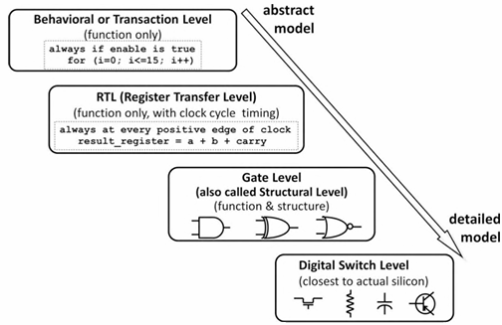
RTL Modelling Fundamentals
Notes:
In RTL, procedural blocks executed in one cycle while Behavioral level takes multiple cycles.
Behavioral level uses full sys verilog with no restrictions while there are in RTL

Slide 4
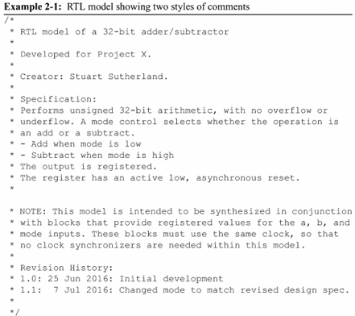
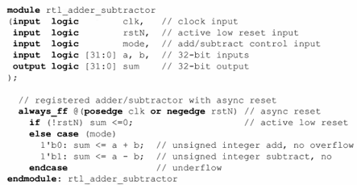
RTL Modelling Fundamentals
Comments
One-line - //
Block Comments - /* */

Slide 5
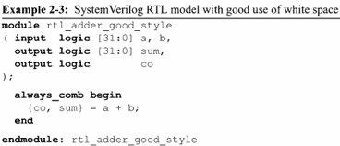
RTL Modelling Fundamentals
White Space
Space or Tabs - Be consistent

Slide 6
RTL Modelling Fundamentals
Identifiers
User-defined names
Must begin with the characters: a through z, A through z, or an underscore ( _ ).
May contain the characters: a through z, A through z, 0 through 9, an underscore ( _ ), or a dollar sign ( $ ).
May be from 1 to 1024 characters in length.
May not be a reserved keyword.
Case-Sensitive

Slide 7
RTL Modelling Fundamentals
Identifiers
Identifiers are local to the name space in which they are declared.
Definition name space
Package name space
Component name space - module, package

Slide 8
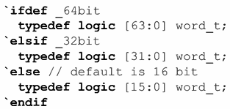
RTL Modelling Fundamentals
Compiler Directives
give commands to compilers that read in SystemVerilog source code
Examples
'include, 'define, 'ifdef, 'ifndef, 'else, 'elsif, 'endif etc.

Slide 9
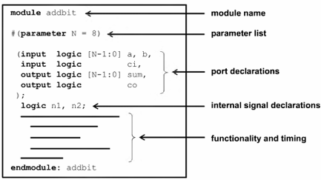
RTL Modelling Fundamentals
Modules
RTL models are zero-delay models

Slide 10
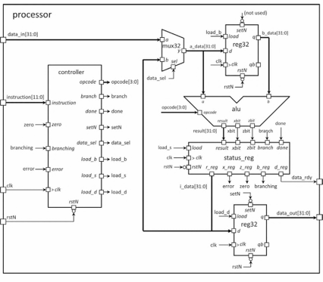
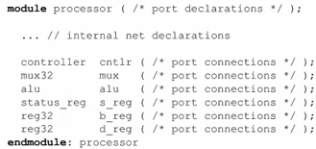
RTL Modelling Fundamentals
Modules instances and hierarchy
Notes:
netlist

Slide 11
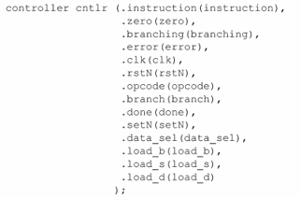
RTL Modelling Fundamentals - Modules instances and hierarchy
Named port connection
Notes:
netlist

Slide 12
RTL Modelling Fundamentals - Modules instances and hierarchy
Named port connection - Dot-star
all nets must be explicitly declared.
the name and vector size must match exactly
the types connected together must be compatible
Notes:
netlist

Slide 13

RTL Modelling Fundamentals - Modules instances and hierarchy
Named port connection - Dot-star
Ports must be explicitly shown as not having a connection using an empty parentheses, such as . qb ().
Notes:
netlist

Slide 14

Net and Variable Types
Avoid mismatch size and value
Notes:
netlist

Slide 15
Net and Variable Types
Four state data values
0 - low
1 - high
Z - Digital High Impedance
X - Uninitilized, Uncertain, Conflict, Don’t Care
Notes:
netlist

Slide 16
Net and Variable Types
Variables - Variables are used as temporary storage for programming. This temporary storage is for simulation.
Nets - Nets are used to connect design blocks together.
Declared using type and data type.
type - indicates variable or a net
data type - indicates 2-state or 4-state.
Example -
var logic a;
wire logic b;
var logic ~ logic
Notes:
netlist

Slide 17
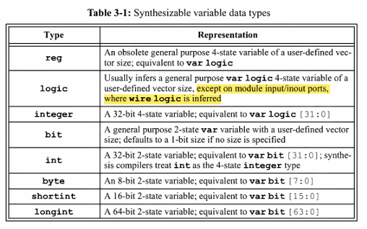
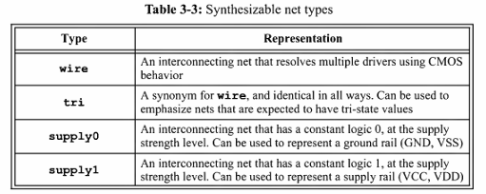
Net and Variable Types
Notes:
netlist

Slide 18
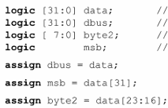
Net and Variable Types
Scalar Variables
logic v5;
Vector Variables
logic [31:0] v9;
constant bit and part selects
Notes:
netlist

Slide 19
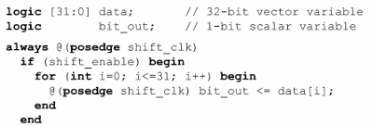
Net and Variable Types
Vector Variables
logic [31:0] v9;
constant bit and part selects
variable bit and part selects
Notes:
netlist

Slide 20
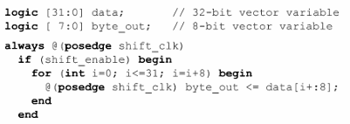

Net and Variable Types
Vector Variables
variable bit and part selects
Notes:
netlist

Slide 21
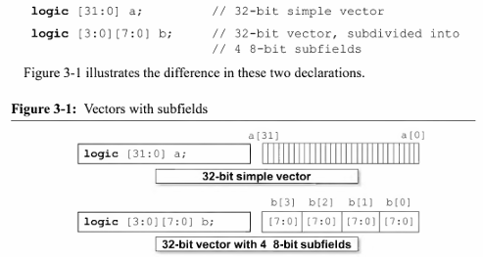
Net and Variable Types
Vector with sub-fields
b[3][7] = ?
Notes:
netlist

Slide 22
Net and Variable Types
Variables can only be assigned by a single source. (Single-source restriction)
if a variable is assigned a value from an assign continuous assignment statement, then it is illegal to also assign the variable a value in a procedural block or from a module input port.
any number of procedural assignments to the same variable is considered a single source. see next slide
Notes:
netlist

Slide 23

Net and Variable Types
Notes:
netlist

Slide 24
Net and Variable Types
Nets:
Single Driver and Multi-Driver Logic:
Single driver - logic
Multiple drivers - wire
input and inout ports infer wire by default
Notes:
Use a logic data type to connect design components together whenever the design intent is to have single driver functionality. Use wire or tri net types only when the design intent is to permit multiple drivers.

Slide 25
Net and Variable Types
Nets cant have subfields.
Nets cannot be used on the left-hand side of procedural assignments.
Nets can be used on the left-hand side of an assign statement.
Avoid connection size mismatches!
Notes:
Use a logic data type to connect design components together whenever the design intent is to have single driver functionality. Use wire or tri net types only when the design intent is to permit multiple drivers.

Slide 26
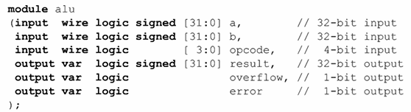
Net and Variable Types
Port Declaration
A port declaration defines a port’s direction, type, data type, sign, size and name.

Slide 27
Net and Variable Types
Use combined ANSI-C style port lists, so that all port information is contained within the port list.
Declare the direction of each port, rather than relying on default port directions and inherited (sticky) port directions. •
Declare all ports data types as the logic data type. Avoid 2-state data types in RTL models — they can hide design bugs. •
Do not declare the port type. Allow the language to infer a wire or var type.

Slide 28
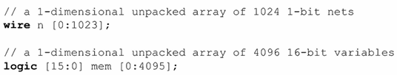
Net and Variable Types
Unpacked arrays of nets and variables
Packed arrays - collection of bits stored contiguously (vectors)
Unpacked arrays - collection of nets or variables

Slide 29
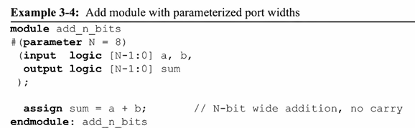

Net and Variable Types
Parameter constants
Parameterized modules

Slide 30
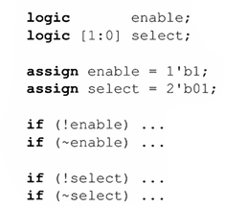
RTL Expression Operators
Concatenate and replicate operators - {m,n} , { r{ } }
Bitwise Operators - ~(invert), &, |, ^
Reduction Operators - &m, |n, ^y
Logical Operators - &&, ||, ! (negate)
OR-reduced
The two 1-bit results evaluated
negate - OR-reduced and inverted.

Slide 31
RTL Expression Operators
Comparison Operators
Operand becomes unknown when a single bit is X or Z
The result of the comparison is unknown 1’bx
Shift Operators - >>, <<, <<<, >>> - beware of >>>
Arithmetic Operators - +, -, *, /, %, ** -
All SystemVerilog arithmetic operators are synthesizable, but specific ASICs and FPGAs might have restrictions on what can be implemented at the gate-level in that device.

Slide 32
RTL Programming Statements
Procedural Block - container for programming statements
initial procedures - verification
always procedures - always_comb, always_ff, always_latch …
LHS of procedural assignments must be a variable.

Slide 33
RTL Programming Statements
Decision statements
if-else in comb logic - mux
if without else in comb logic - latch
if-else-if in comb logic - priority encoded behavior
if-else evaluated on clk edge - flip flop

Slide 34
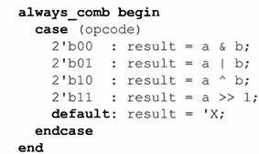
RTL Programming Statements
Decision statements
case statements
case items - priority encoding if two or more items are true
case items - parallel evaluation if two items can’t be true

Slide 35
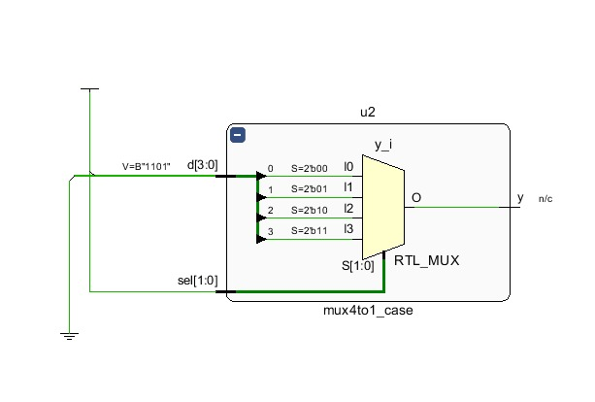
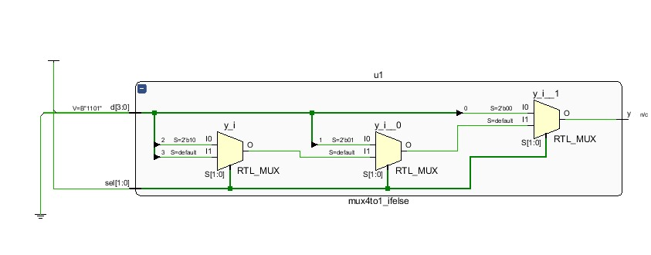
RTL Programming Statements
Implementing 4 to 1 MUX using if-else-if
Implementing 4 to 1 MUX using case

Slide 36
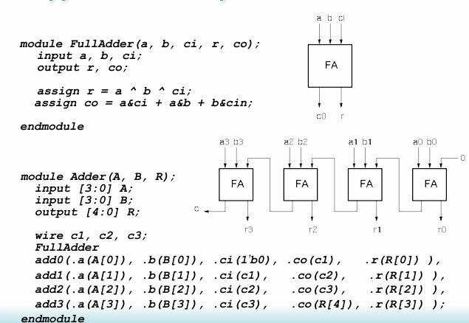
RTL Programming Statements
Generate Loop

Slide 37
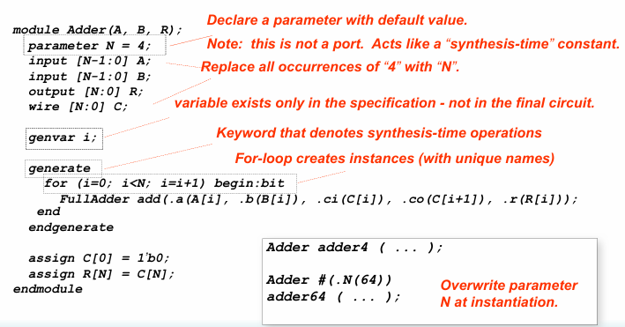
RTL Programming Statements
Generate Loop

Slide 38
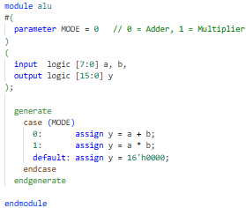
RTL Programming Statements
Generate Case

Slide 39
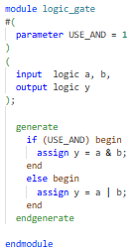
RTL Programming Statements
Generate If

Slide 40
Modelling Combinational Circuits
Continuous assignment
LHS can be scalar or vector net / variable
Can’t be unpacked struct or unpacked array
multiple continuous assignments in a module run in parallel, the order of the assignments in the RTL source code makes no difference.

Slide 41

Modelling Combinational Circuits
always_comb
Any variable assigned a value in an always_comb procedure cannot be assigned from another procedure or continuous assignment.
Only use blocking assignments (= ) when modeling combinational logic behavior.

